Slide 1

Project Work
Attitude Towards Immigration
Brader, Valentino and Suhay (2008) Framing Experiment Data
Fundamentals of Data Science
So.Se 2019
Cipriani Antea & Uhlar Juraj

Slide 2
Dataset
a 2008 survey study looking at attitude to migration in US citizens
Demographic data: age, income, education, gender
Measuring attitude to immigration on a 4 point scale & other related variables:
Perceived harm caused by immigration
Anxiety about immigration
Emotional state during the experiment etc.
Action taken or info requested about immigration
2 manipulated study conditions
Tone of the news article: Positive or Negative
Ethnicity clues about immigrants: European or Latino

Slide 3
Prediction task
Predict an individual’s attitude towards immigration with the data available.
We converted the 4-scale factor `immigr` into a binary variable, where values 1 and 2 stand for “rather positive” attitude and values 3 and 4 for “rather negative” attitude.

Slide 4
Data problems
No missing values or skewed distribution
The study was well designed with the sample well representing the US population
Just cleaned up, factorized variables
But the description and dictionary where a little incomplete and we have a suspicion that some variables were coded or described incorrectly

Slide 5
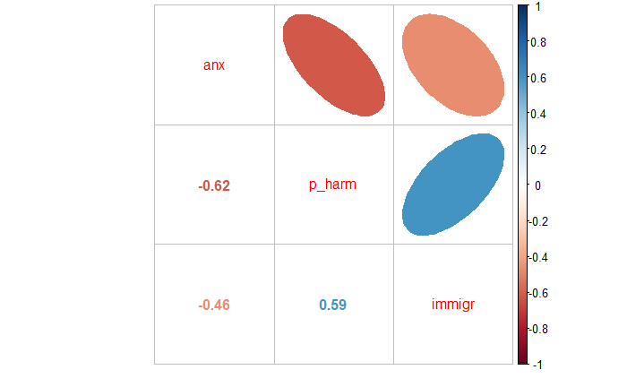

Slide 6
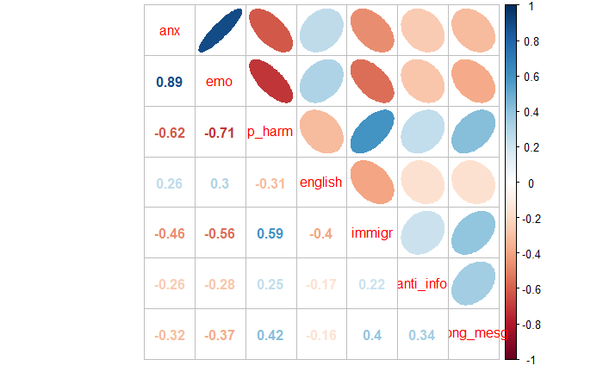
This should all be blue, but isn’t

Slide 7
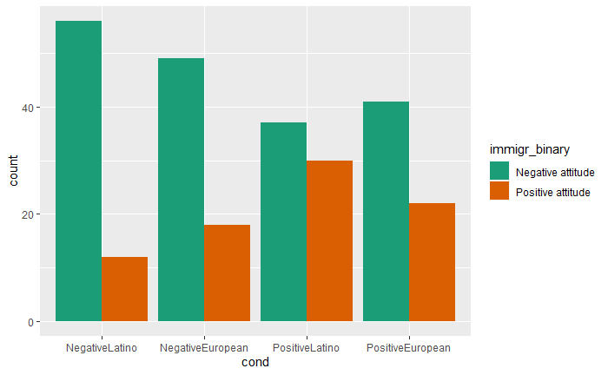
Study conditions x Immigration attitude

Slide 8
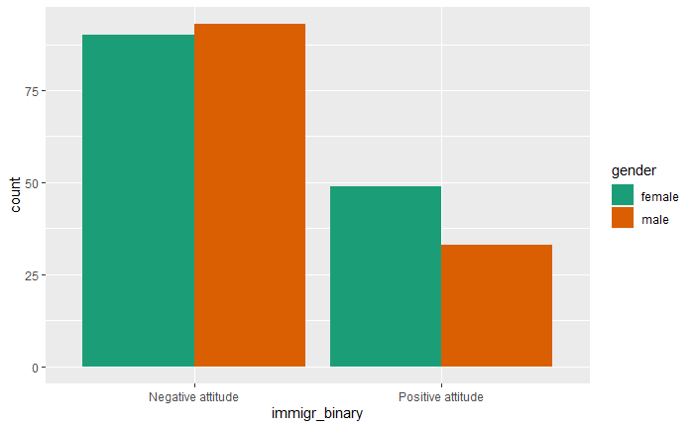
Gender x Immigration attitude

Slide 9
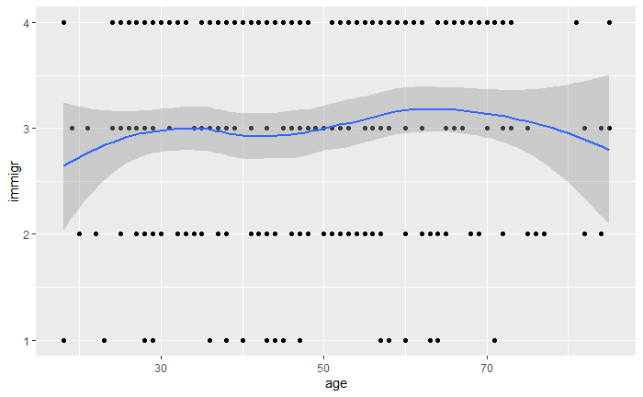
Age x Immigration attitude

Slide 10
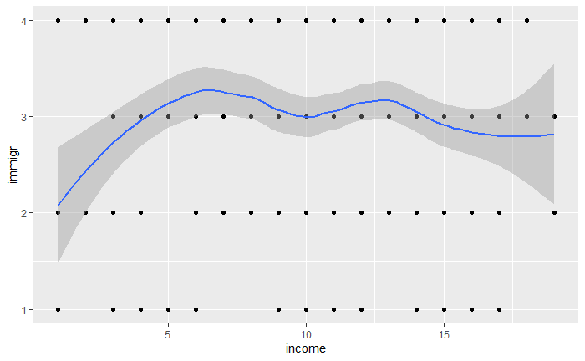
Income x Immigration attitude

Slide 11
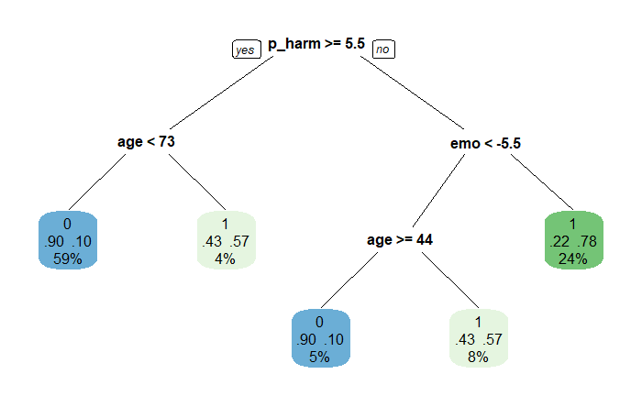
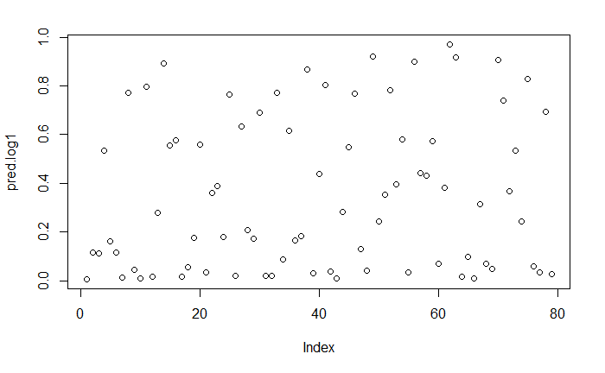
Models
vs

Slide 12
Models
 | Naive baseline | Decision Tree model | Logistic regression model
AUC | 0.5 | 0.76 | 0.89
RMSE | 0.46 | 0.41 | 0.35

Slide 13

Thanks!

